Slide 1



HOW DOES MARKETING INFLUENCE PEOPLE'S PURCHASES
Presenter: Avinash Rajendran
UNIVERSITY OF THE PACIFIC
www.canva.com

Slide 2

TABLE OF CONTENT
Introduction
Topic, Scope, Purpose
State of consumer consciousness
Consumers Behavior
Factors influencing consumer behavior
Analyzing marketing techniques
Child-appealing marketing
Marketing Strategies for dietary supplements
Alcohol Advertising
Future consideration
Things to consider before making a purchase
Conclusion
www.canva.com

Slide 3

INTRODUCTION
Topic: How does marketing influence people's purchases?
Scope: Investigate and learn about the tactics that businesses use to convince customers to purchase their products.
Purpose: By being aware of the tactics businesses use to promote their goods, we as consumers can modify our buying habits.
www.canva.com

Slide 4

State of consumer consciousness
CONSUMERS BEHAVIOR
When choosing, buying, using, and discarding goods or services to fulfill specific needs or desires, people go through a number of mental and emotional processes as well as physical activities.
www.canva.com

Slide 5

FACTORS INFLUENCING CONSUMER BEHAVIOUR
Culture
Personal
culture, subculture, social class system
age / life-cycle stage, occupation, economic circumstances, lifestyle, personality
Social
Psychological
reference groups, family, roles and status
Motivation, perception, learning, beliefs and attitudes
www.canva.com

Slide 6

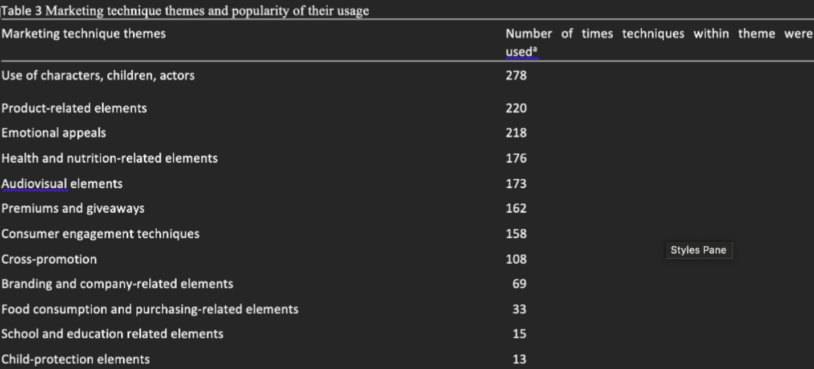
Analyzing marketing techniques
CHILD-APPEALING MARKETING
www.canva.com
Childhood overweight, obesity, and diet-related chronic disease
Audience-based criteria - the type of channel/website (e.g., on a cartoon network), airing time.
Content-based criteria - visual appeals (e.g., graphic design, animation)
(Mulligan et al., 2020)

Slide 7
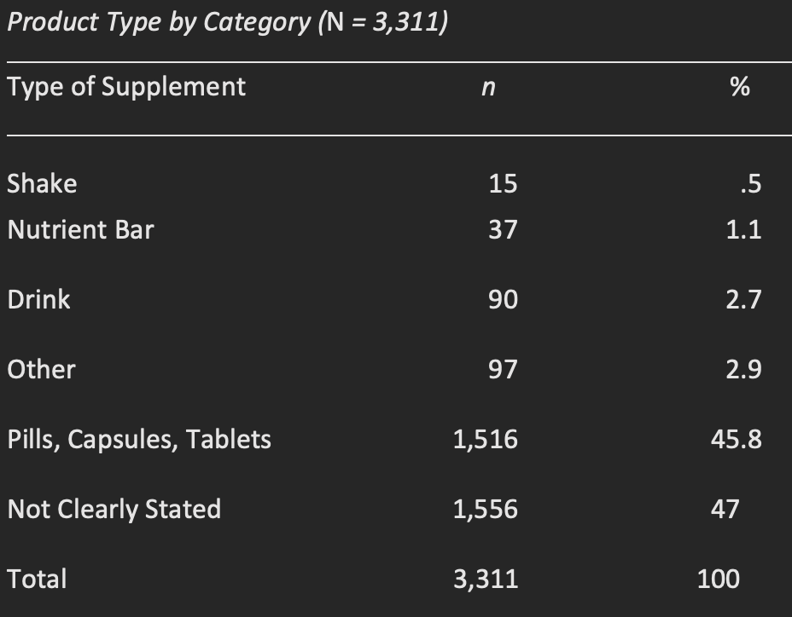
MARKETING STRATEGIES FOR DIETARY SUPPLEMENTS
Product Type
Key Terms
DSHEA Warning
Health Claims
Celebrity/Athlete
(Ethan et al., 2016)
www.canva.com

Slide 8
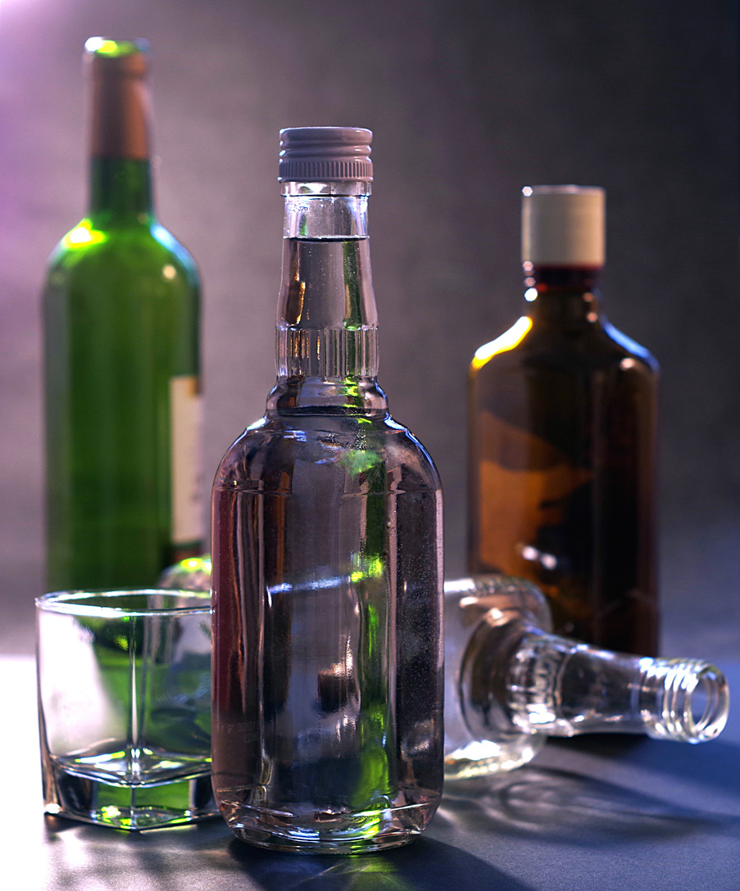
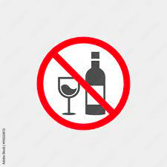
ALCOHOL ADVERTISING
Product appeals
Character appeal
taste, health benefits, cost, and quality
Helps target market identify with the advertisement and the product
Production appeal
Risk appeal
fashion that encourages thought
associated with adventure/performance
Youth-oriented genre appeals
www.canva.com
magic, violence, fantasy, humor

Slide 9
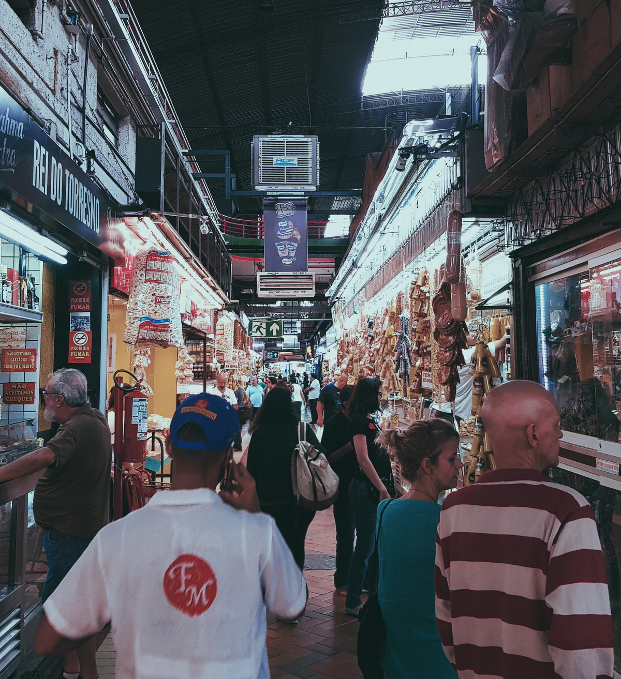
FUTURE CONSIDERATION
Things to consider before making a purchase
Reviews
Price
Length of use
Quality
Necessity
www.canva.com

Slide 10

CONCLUSION
Corporations try to influence consumers to buy their products through advertisements promoted on websites, and social media, by well-known figures
Purchase goods that we actually need, have long lifespans, good quality
Should always have the power to decide.
www.canva.com

Slide 11
THANK YOU

Slide 12
REFERENCES
Bearden, W. O., Ingram, T. N., LaForge, R. W. (2005). Marketing: Principles and Perspectives. United Kingdom: McGraw-Hill Higher Education. https://www.google.com/books/edition/Marketing/bJkfAAAACAAJ?hl=en
Coleman, P. C., Hanson, P., van Rens, T., & Oyebode, O. (2022). A rapid review of the evidence for children’s TV and online advertisement restrictions to fight obesity. Preventive Medicine Reports, 26, 101717. https://doi.org/10.1016/j.pmedr.2022.101717
ETHAN, D., BASCH, C. H., BERDNIK, A., & SOMMERVIL, M. (2016). Dietary Supplements Advertised in Muscle Enthusiast Magazines: A Content Analysis of Marketing Strategies. International Journal of Men’s Health, 15(2), 194–202. https://0-doi.org.pacificatclassic.pacific.edu/10.3149/jmh.1502.194
Hartley, S. W., & Patti, C. H. (1988). Evaluating Business-To-Business Advertising: A Comparison of Objectives and Results. Journal of Advertising Research, 28(2), 21.https://scholar.google.com/citations?view_op=view_citation&hl=en&user=R-r5oxIAAAAJ&citation_for_view=R-r5oxIAAAAJ:Tyk-4Ss8FVUC
Mora Cortez, R., Gilliland, D. I., & Johnston, W. J. (2019). Revisiting the theory of business-to-business advertising. Industrial Marketing Management. https://doi.org/10.1016/j.indmarman.2019.03.012
Mulligan, C., Kent, M. P., Christoforou, A. K., & L’Abbé, M. R. (2020). Inventory of marketing techniques used in child-appealing food and beverage research: A rapid review. International Journal of Public Health, 65(7), 1045–1055. https://0-doi.org.pacificatclassic.pacific.edu/10.1007/s00038-020-01444-w
Sharma, M., Batra, K., & Lakhan, R. (2020). Alcohol Advertising: Implications for Reducing the Negative Impact on Underage Drinking. Journal of Alcohol and Drug Education, 64(3), 9–22. https://go.gale.com/ps/i.do id=GALE%7CA654337364&sid=googleScholar&v=2.1&it=r&linkaccess=abs&issn=00901482&p=AONE&sw=w&userGroupName=anon%7Ebc283632

